Slide 1
Prohibition 2020
Teresa Barajas, Sarah Heckman, Austin Edrington, Jay McDermott

Slide 2
A Brief History Lesson…
Prohibition was ratified by Congress as the 18th Amendment to the United States Constitution on January 16, 1919.
To celebrate its 100th anniversary, our team set out to determine whether the 21st Amendment, which was enacted to repeal the previously instated 18th, was the correct move.
Other than looking at the direct effects of drinking, which has already been highly researched, we sought to uncover the potential impact bars have on society by looking at the availability of other resources.

Slide 3
Bars and its Effect on Communities
We know that excess consumption of alcohol has a negative affect on physical and mental health – but what about the access to or proximity of alcohol?
Using Yelp APIs and a city population CSV, we sought to uncover if a correlation exists between a higher number of bars per capita and…
City size
Health – Fast food, Gyms
Culture – Parks, Book Stores
Do more bars per capita correspond with an increase of unhealthy behavior?

Slide 4
Hypothesis –
Hypothesis:
If there are more bars per capita, then unhealthy options will increase and healthy options decrease
Null:
If there are less bars per capita, then unhealthy options will decrease and healthy options increase

Slide 5
Using API Requests

Slide 6
Objective
Use API calls to find the total number of
Bars
Parks
Churches
Gyms
Bookstores
Fast food restaurants
Notes:
We wanted to flex our new API call skills to find and store the total number of all these different types of establishments in almost 400 cities.

Slide 7
Method
Yelp API business search
Notes:
I decided to use Google API but found they have a results cap of 20 results per page. Rather than trying to finagle a work around, we decided to switch to Yelp API since the total number of results is included on the results page.

Slide 8
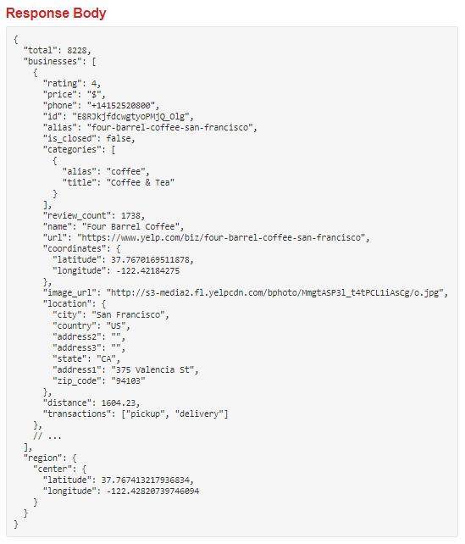
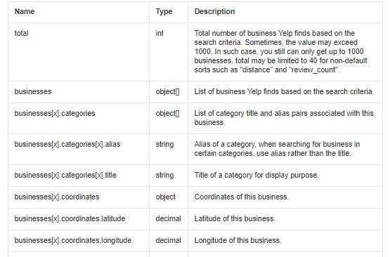
Notes:
We found this after doing a simple google search for “yelp api total number of bars”

Slide 9
Method
Yelp API business search
Imported a Yelp API wrapper
Notes:
It was infuriating trying to get the Yelp API to work, until I remembered such things as API wrappers exist!

Slide 10
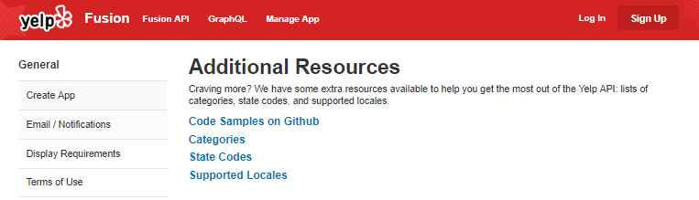
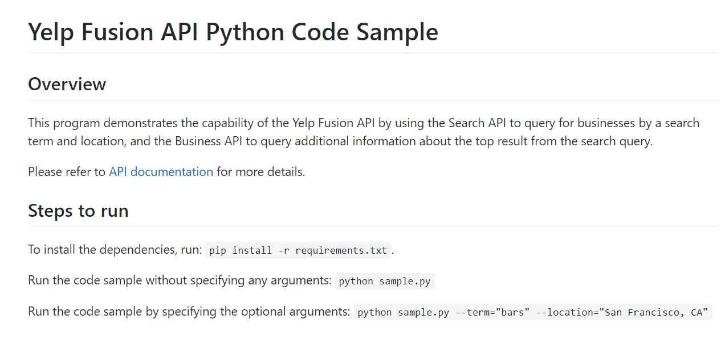
Notes:
Where did I find this magical wrapper you ask??? I basically scoured the Yelp Fusion site out of desparation and Ta-daa I found a solution that worked.

Slide 11
Method
Yelp API business search
Imported a Yelp API wrapper
Read in a CSV containing cities and populations
Multiple for loops – 1 for each type of establishment
Notes:
Austin found the data set that we pulled our list of Cities from. Bonus for Yelp API - you don’t have to have latitudes and longitudes!
I used the Nearest Restaurant example from class to write multiple for loops. Thank you ERIC!

Slide 12
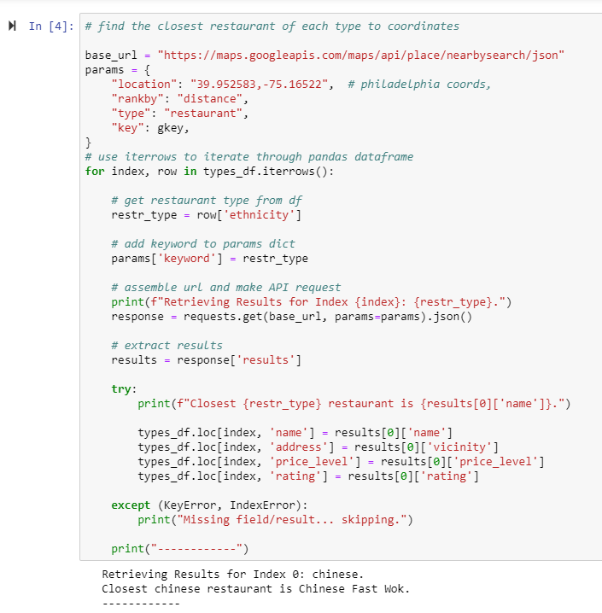
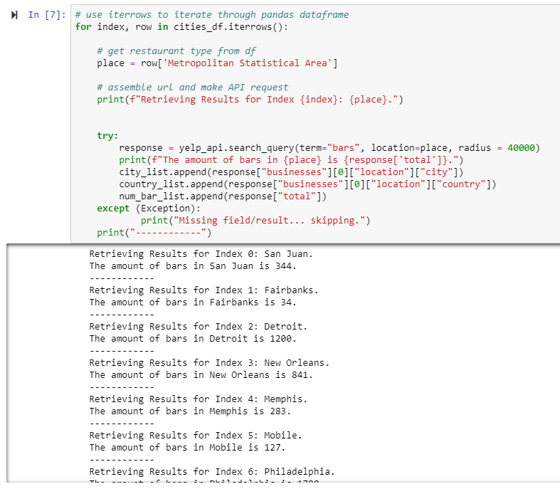
Eric’s code
My code

Slide 13
Method
Yelp API business search
Imported a Yelp API wrapper
Read in a CSV containing cities and populations
Multiple for loops – 1 for each type of establishment
Zipped results into a data frame
Pushed to a new CSV.
Notes:
The loops stored their results into lists and from there I used Pandas to convert the lists to 1 data frame.
Finally, I pushed the data frame to a CSV for my team to clean and analyze.

Slide 14
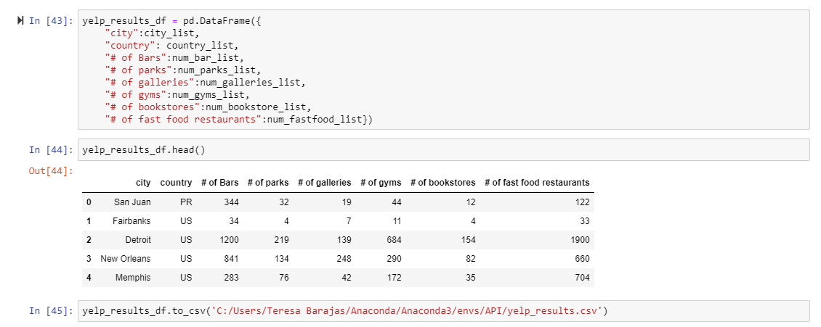

Slide 15
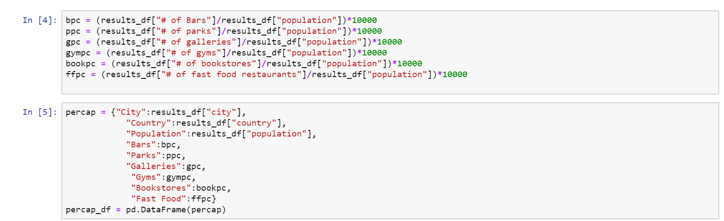
Per Capita Calculations

Slide 16
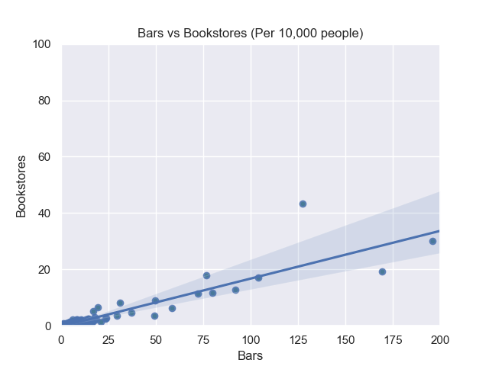
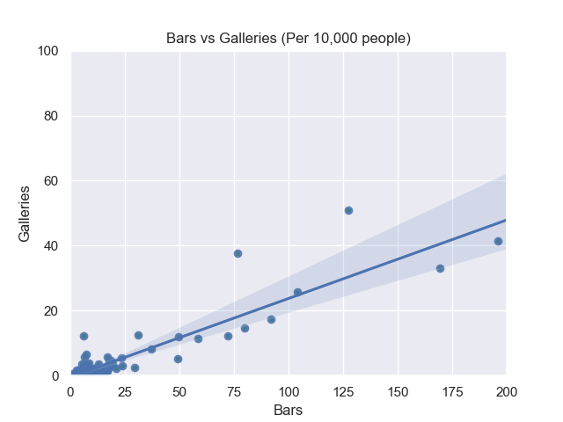

Slide 17
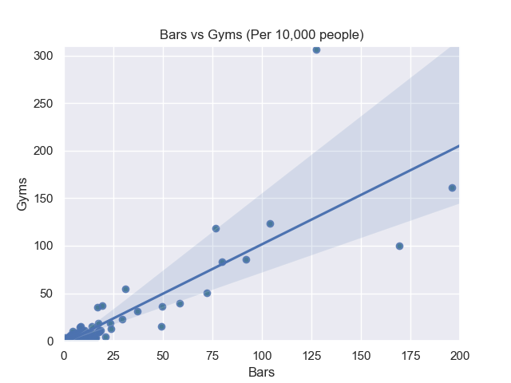
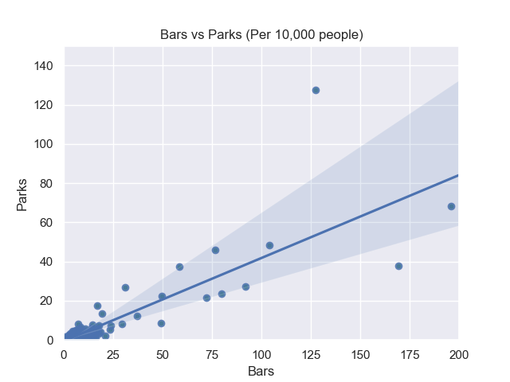

Slide 18
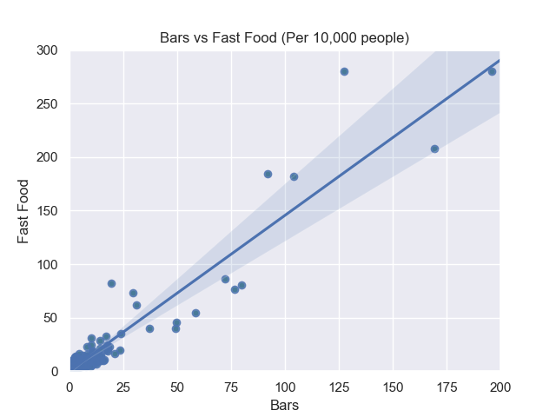

Slide 19
Hypothesis – ANOVA Analysis
Hypothesis:
If there are more bars per capita, then unhealthy options will increase and healthy options decrease
Null:
If there are less bars per capita, then unhealthy options will decrease and healthy options increase

Slide 20
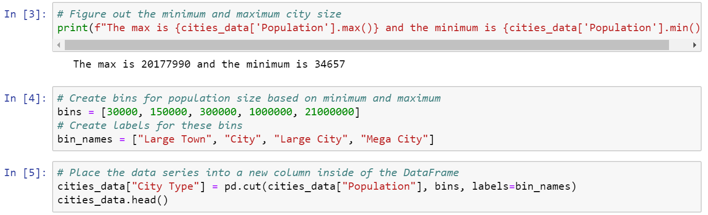
ANOVA Analysis

Slide 21
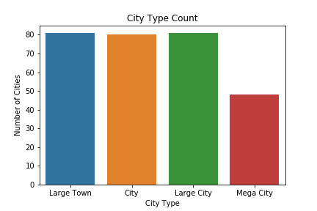
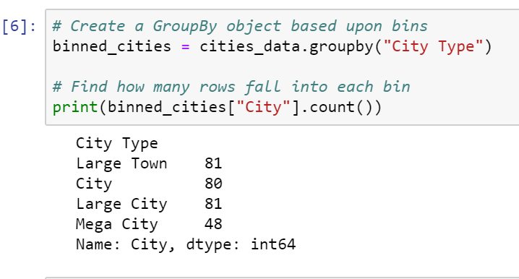
ANOVA Analysis

Slide 22
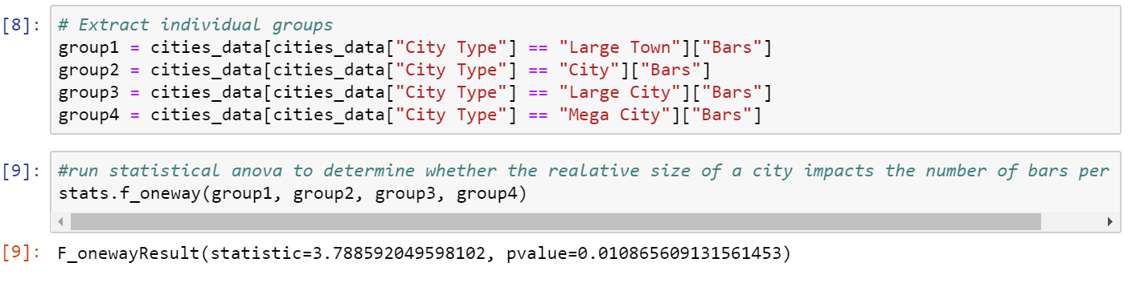
ANOVA Analysis
With a p-value of 0.01, we can reject the individual null hypothesis that the number of bars per capita stays the same as city size increases

Slide 23
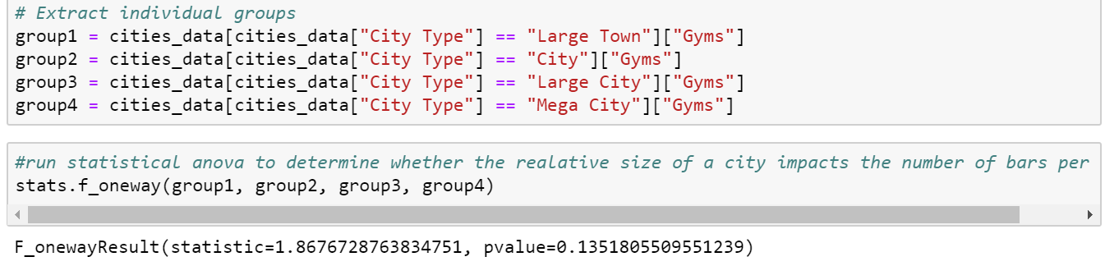
ANOVA Analysis
Run the test for gyms, fast food options, parks, galleries, and bookstores
Gyms – p-value = 0.135, accept the null

Slide 24
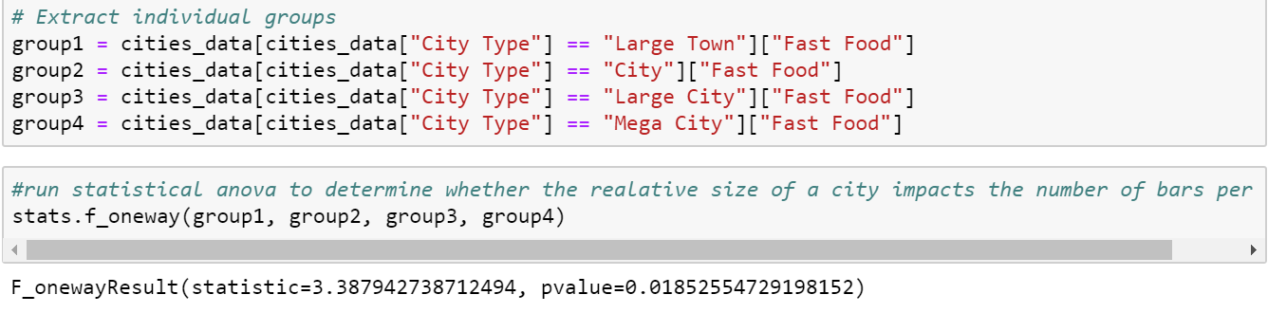
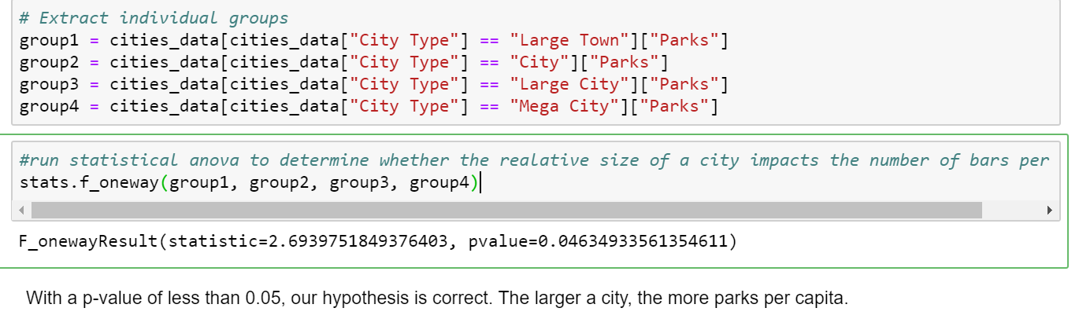
ANOVA Analysis
Fast food – p-value = 0.018, reject the null
Parks – p-value = 0.046, reject the null

Slide 25
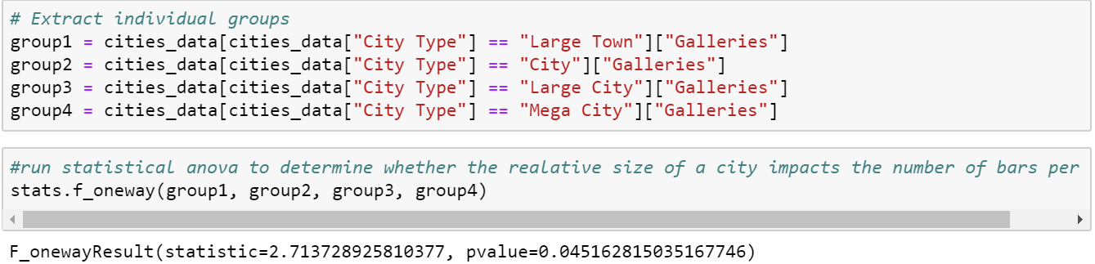
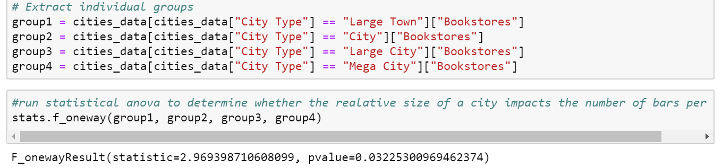
ANOVA Analysis
Galleries – p-value = 0.045, reject the null
Bookstores – p-value = 0.032, reject the null

Slide 26
Takeaways
The most significant p-values were: Bars, Fast Food, and Gyms
The idea that as the number of bars per capita increases, fast food options increase and the number of gyms doesn’t change mean that, in terms of physical health, these values correlate.
Hypothesis is proven: The more bars per capita there are, the number of unhealthy options will increase.

Slide 27
Headwinds
API key cap
Some cities were not found
The API syntax was tricky: “fastfood” vs “fast food”
Notes:
The biggest challenge for this project was maxing out my API keys. The Yelp API has a limit of 5,000 calls per day. Since I was doing 6 loops, 400 calls each, I quickly maxed out my own key. I found that creating check points throughout the code saved time and valuable API calls.
There were several cities that couldn’t be found but thanks to the Nearest Restaurant source code, a simple Try and Except statement allowed us to keep moving.
I can’t stress enough how important it is to look at the results as they’re coming in! The API call for “fast food” was delivering results but stated there was only 3 fast food restaurants in New Orleans (and none of them were Popeyes!) After simply taking out the space between “fast” and “food” the results were looking way more realistic.
Also, since API calls are just a shortcut of running a simple Yelp search, we validated a sample of the results just using the Yelp.com website.

Slide 28
Thanks!
Questions?

